Slide 1
Assignment 1: Review

Slide 2
Did Everyone Sign Up for the Zybook?

Slide 3
Lecture 1
Searching and Sorting

Slide 4
Pop Quiz from Last Week
Java Basics:
What is the difference between an “int” and an “Integer” in Java?
Explain what static and non-static methods are.

Slide 5
Searching and Sorting
Very common in real world database applications
Medical records, phone contacts, product inventory
Goal is to find a record based on a name or an ID number to then use other information in that record
The concept of efficiency becomes important when comparing algorithms
With large lists, there will be many operations. So a small performance decrease in each operation can result in huge changes to the total time

Slide 6
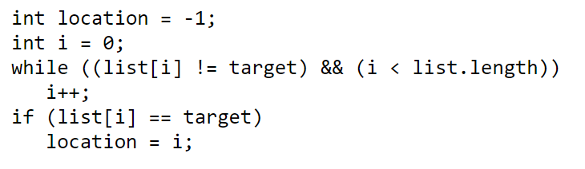
Linear Search
Searches from beginning of list to end (also called sequential)
Contains N number of elements

Slide 7
Linear Search
Best Case
1 Comparison
Average Case
N/2 Comparisons
Worst Case
N Comparisons
The best case doesn’t tell us much about the efficiency of this search method
Any search would perform as well if the first comparison is successful
The average and worst cases give us more useful information to compare to other methods

Slide 8
Linear Search
If the list grows in size, the number of comparisons for both the average and worst cases grow linearly
Called linear search because its complexity/efficiency can be represented as a linear function

Slide 9
Binary Search
Useful for an alphabetically or numerically sorted list
Begins in the middle of the list and checks if the desired data comes before or after the current element
It then selects either the first or second half and repeats the process, further narrowing its search
Each step of the search reduces the possible locations by half

Slide 10
Binary Search
Faster than linear search if the list is sorted and each element is directly accessible
i.e. an array
The maximum number of comparisons is found with the following expression:
Exponentially faster than linear search for large lists

Slide 11
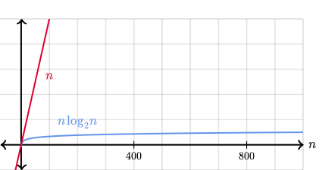
Linear Search vs. Binary Search Efficiency
Time
N

Slide 12
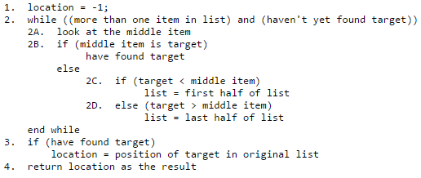
Binary Search Pseudocode

Slide 13
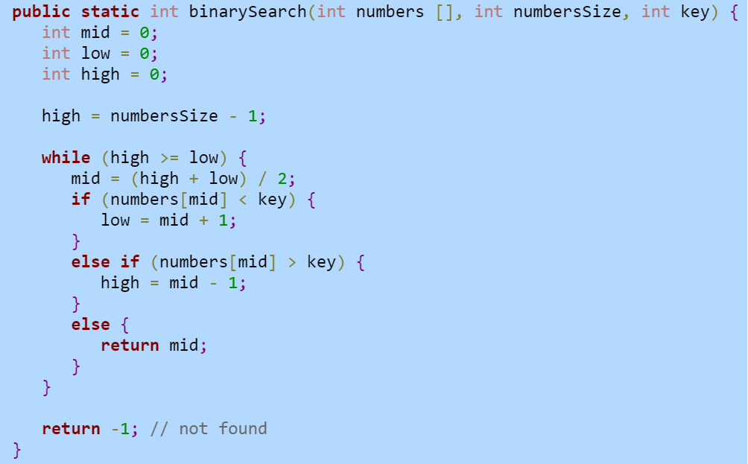
Binary Search Function

Slide 14
Binary Search Example
On the board

Slide 15
Big O Notation
A way to compare runtimes of different algorithms
Based on the input size
All functions that have the same growth rate are considered the same in Big O notation

Slide 16

Big O Notation
Highest order terms are kept
If expression is a product, all constants are omitted
O(N^2)
Pronounced “Oh N Squared”

Slide 17
Big O Example
400 + N + 1000N^2 + 2N*N + 50N^3

Slide 18
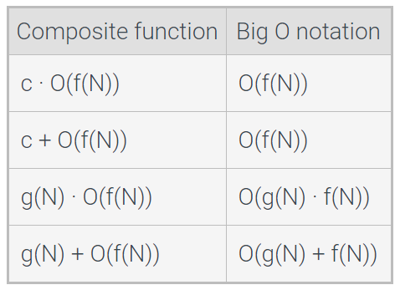
Big O Composite Functions

Slide 19
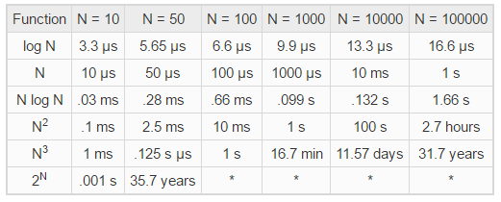
Growth Rate

Slide 20
Constant Time Operations
A constant time operation is an operation that, for a given processor, always operates in the same amount of time, regardless of input values.
However, an algorithm can always execute more quickly on a faster processor
Most modern processors perform arithmetic operations on integers and floating point values at a fixed rate that is unaffected by operand values.
Part of the reason for this is that the floating point and integer values have a fixed size.

Slide 21
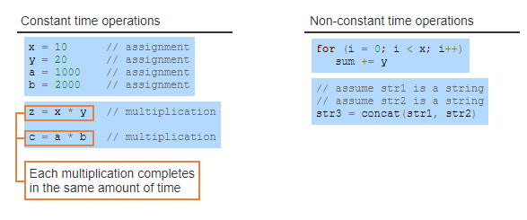

Slide 22
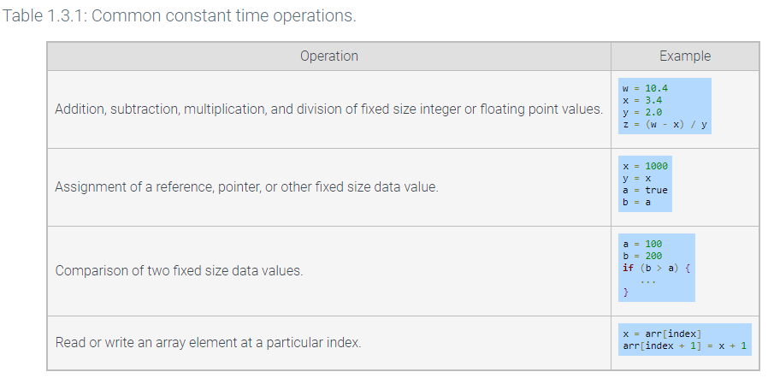

Slide 23
Complexity of Algorithms
Detailed in Zybooks
All the types have an associated level of complexity

Slide 24
Sorting
Process of converting a list into ascending or descending order
Can be numerical or alphabetical
It is desirable to store our data sorted to enable more efficient searching operations
i.e Binary Search

Slide 25
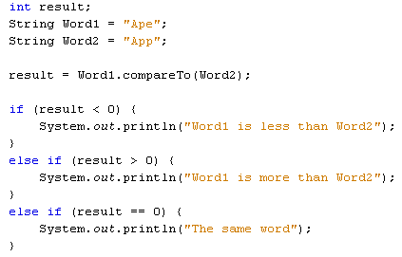
Example of Sorting Words Alphabetically

Slide 26
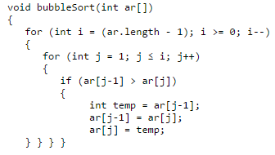
Bubble Sort Example

Slide 27
Bubble Sort Example
Keep count of how many
times we need to run algorithm
Go through each element
Check if swap is needed
Swap elements

Slide 28
Quiz on Canvas
Topic: Searching
Due next Tuesday night, check canvas

Slide 29
Zybooks Sections
1.1, 1.2, 1.3, 1.5, 1.10

Slide 30
Assignment 2
With an example to help get started

